Slide 1


Password Cracking in Parallel
CMP202 Jake Bretherton 1800231

Slide 2
The Problem:
Find an unknown password from a given hash.
Passwords are stored in a hashed format, meaning if there is a leak of a website’s databases raw passwords will not be visible.
A password cracker will take a hash, and by brute force try possible passwords until one hashes into the provided hash.
Guess | Hash | Same As Leak?
Pass0 | 348468795 | No
Pass1 | 487314782 | Yes
(Actual Password) | Leaked Hash
Pass1 | 487314782
Found!

Slide 3
Simplifications
This is a toy model:
The hashes will not be salted
The hash algorithm used will not be cryptographically secure
It the principle is the same but the program will run significantly faster
C++ has a built in hash function for dictionary keys
Ethically, this will not be usable on actual leaks

Slide 4
Breaking down the problem
Crack the password:
Generate Password guesses
Hash the Password guess
Compare generated hash to provided hash
Return found password

Slide 5
Note on generating password guesses
There are 95 commonly used Unicode characters in passwords
a-z
A-Z
0-9
!"# $%&'()*+,-./:;<=>?@[\]^_`{|}~
Complete sequential block of characters from space to tilde, ‘ ‘ to ‘~’, char 32 to 126
*(1 – 1/96)
aFeg
aFeh
aFei
aFej
aFek
aFel
aFem
aFen
aFeo
aFep
aFeq
aFer
aFes
aFet
aFeu
Almost every new guess will be the previous guess, with the last character incremented
Therefore 98.9%* of generation is taking the last character and incrementing it by 1

Slide 6
Breaking down generation
Expensive algorithm to increment the password root
Can handle if last character of root is largest char
Can handle adding new character to root if whole root is largest char
Cheap algorithm to increment the last character
Increment char and store it along with the root
Signal to expensive algorithm if char is largest char
98.9% of generations use only cheap algorithm
aFe- | -p | aFep
Root | Last character | Password

Slide 7
Breaking down the problem
Crack the password:
Generate Password guesses
Increment password root
Increment the last character
Hash the Password guess
Compare generated hash to provided hash
Return found password

Slide 8
Model
Thread
Generator
Single character
Channel
Plain Text Password
Thread
Perform Hash
Channel
Password Hash Pair
Thread
Compare Hash to Target
Write
Read
Write
Read
Signal
Barrier
Update
Write
If Match
Thread
Generator
Root word
Thread
Wait for end of Search
Channel
Found Password
Read
Begin
Provide Hash
End
Return Password

Slide 9
Thread managing tools
Need:
Barrier
Suspends threads that reach barrier until specified number of threads reach barrier, at which point all are awoken
Channel
Pipe to pass data between threads
Reading threads suspend until data is available, writing threads suspend until there is room in the channel
These require a semaphore
Semaphore
Signal a count between threads
If count > 0, threads waiting for signal will decrement count and continue
If count = 0, threads waiting for signal will suspend until count > 0, when they will wake up
A thread signalling the semaphore will increment the count and wake up a sleeping thread waiting on the semaphore
None of these are available in the current version of C++ so they had to be written

Slide 10
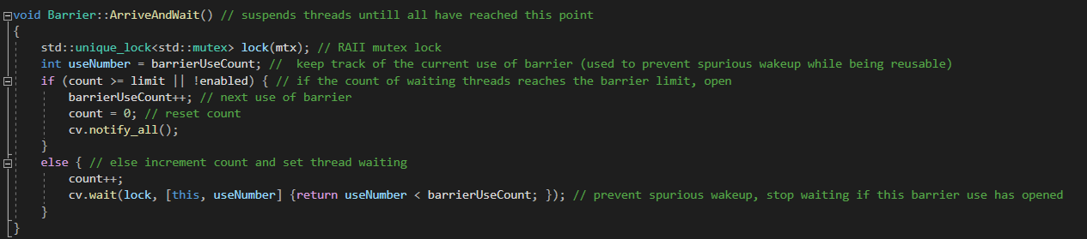
Barrier
Arrival to the barrier is protected by a mutex lock, as it requires modifying the state of the barrier to increase the number of counted arrived threads (and possibly unlocking the barrier. There is an inherent race condition to arriving.
If not all threads have arrived at the barrier then the thread is suspended and the mutex lock automatically released.

Slide 11
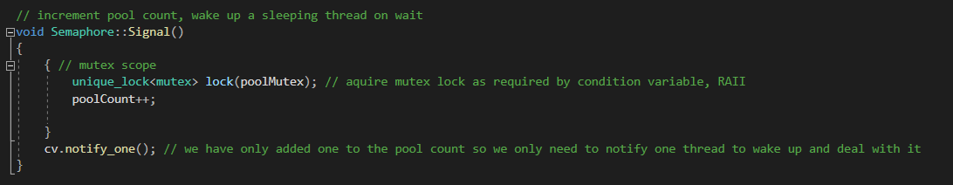
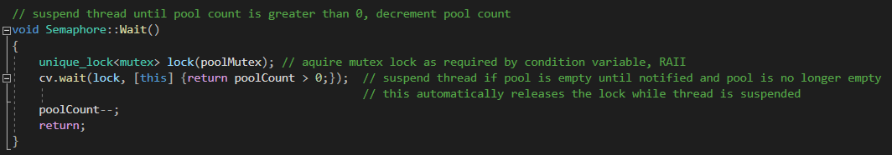
Semaphore
A mutex lock is acquired as signalling and waiting on a semaphore both alter the pool count and therefore represent a race condition.
If the thread suspends waiting for a signal then the mutex it automatically released until woken up (when it reacquired)

Slide 12
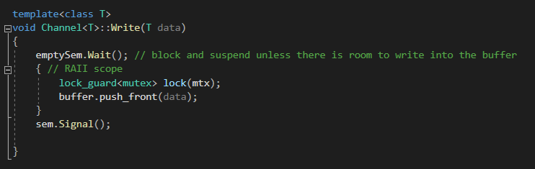
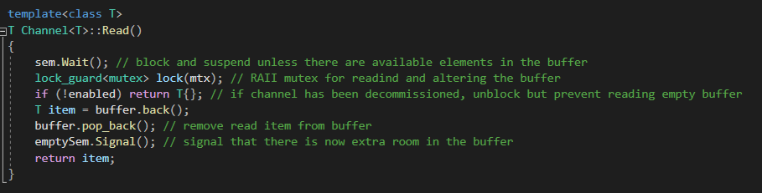
Channel
Requires two semaphores, one to hold the number of elements in the channel, another to hold the number of empty spaces in the channel.
A mutex lock is needed to write to the channel, as well as read from it as reading removes the item read.

Slide 13
Model
Thread
Generator
Single character
Channel
Plain Text Password
Thread
Perform Hash
Channel
Password Hash Pair
Thread
Compare Hash to Target
Write
Read
Write
Read
Signal
Barrier
Update
Write
If Match
Thread
Generator
Root word
Thread
Wait for end of Search
Channel
Found Password
Read
Begin
Provide Hash
End
Return Password

Slide 14
Generator threads
Last Character Thread
Root Password Thread
Take root and add character to it, write this to channel and increment character
When exhausted characters, arrive and wait to signal the root should be updated
Arrive and wait for root password to be updated
Arrive and wait for generation to finish
Update the root password
Once finished arrive and wait to signal generation may begin again

Slide 15
Generation to hashing
Hashing thread initially tries to read the password plaintext channel
This channel is empty so the thread suspends
The last character generator thread writes a string to the channel
This causes the hash thread to wake up and hash the password
Thread
Generator
Single character
Channel
Plain Text Password
Thread
Perform Hash
Write
Read

Slide 16
Hash to comparison
Comparison thread tries to read the hash channel
This channel is empty so the thread suspends
Hash channel writes both the hash it has generated and the plaintext used to generate it to the hash channel
This causes the comparison thread to wake up and compare this hash to the provided search hash
Thread
Perform Hash
Channel
Password Hash Pair
Thread
Compare Hash to Target
Write
Read

Slide 17
Comparison to end search
End search thread tries to read the hash channel
This channel is empty so the thread suspends
If the comparison thread finds the hash did not match the target, it discards the hash and password
If they match then the comparison thread writes the associated password to the end search channel
This causes the end search thread to wake up and stop and join the rest of the threads
Thread
Compare Hash to Target
Channel
Found Password
Thread
Wait for end of Search
Write
Read

Slide 18

Function Timings

Slide 19
Specs of machine timed on
Processor: Intel Core i5-1035G1, quad core 1GHz
Cache 6MB

Slide 20
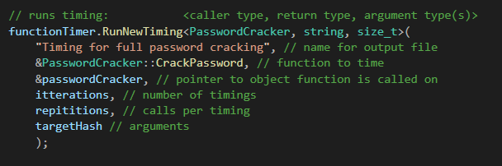
Function timer
Wrote a function timer object to run timings on various methods of the program
You can specify the number of timings to perform, and the number of calls to that function per timing

Slide 21
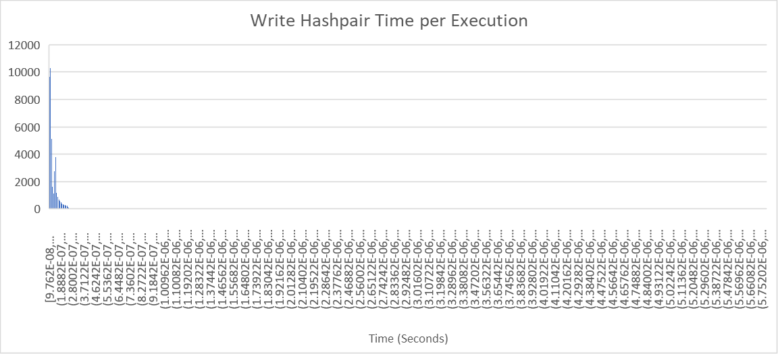
Issues with timings
Because the entire solution is fairly complex with many threads that likely spend a significant amount of execution suspended, it was decide to time each task independently. Reading / writing to each channel, and each thread’s work were timed.
Because timing such small segments of code, the high-resolution clock often would not register any time having passed between executions, so many executions were done per timing, and this was repeated many times.
Outliers made histogram graphing difficult, this is a naïve attempt with evenly spaced buckets from the minimum to maximum value

Slide 22
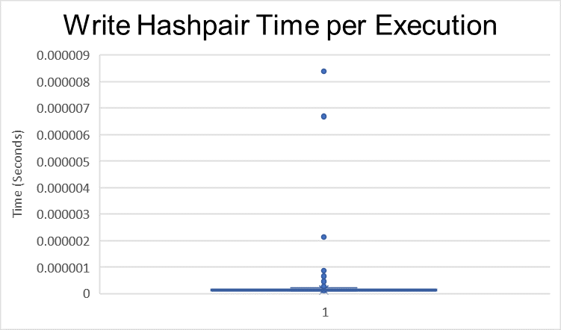
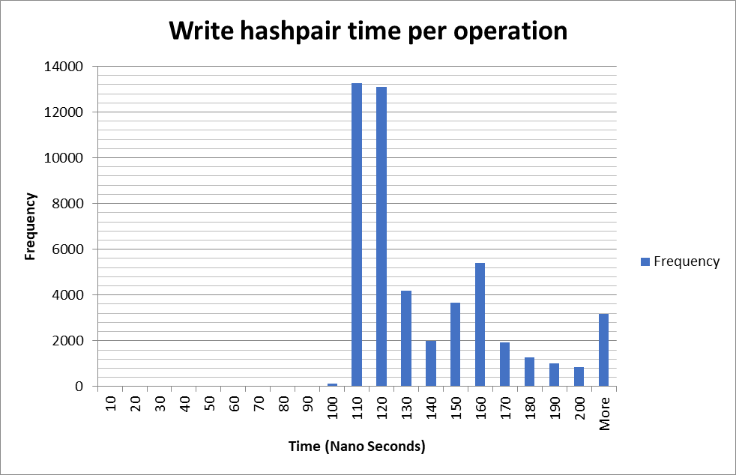
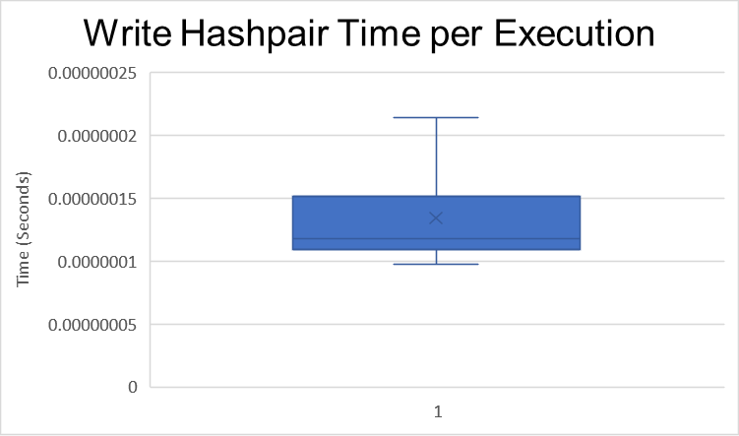
Issues with timings - Solution
The outliers were so extreme they dwarf the rest of the data
Box and whisker plots were used to visualise the data excluding these outliers.
The Minimum (Q1–1.5*IQR) and Maximum (Q3+1.5*IQR) were then used for the histogram extremes, and outliers all grouped in ‘more’
Median Time: 118 Nanoseconds

Slide 23
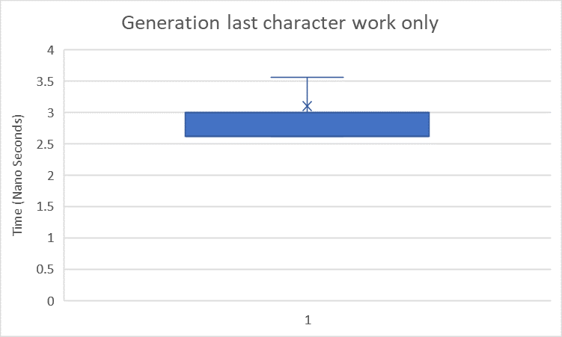
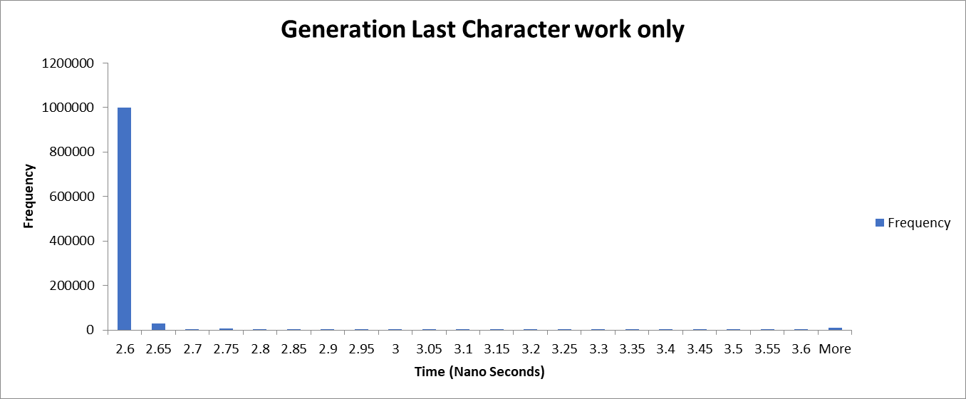
Generation last character
50,000 timings of 50,000 executions of the last character generation only (no channel writing) Theoretical time per execution
Median Time: 2.62 Nanoseconds

Slide 24
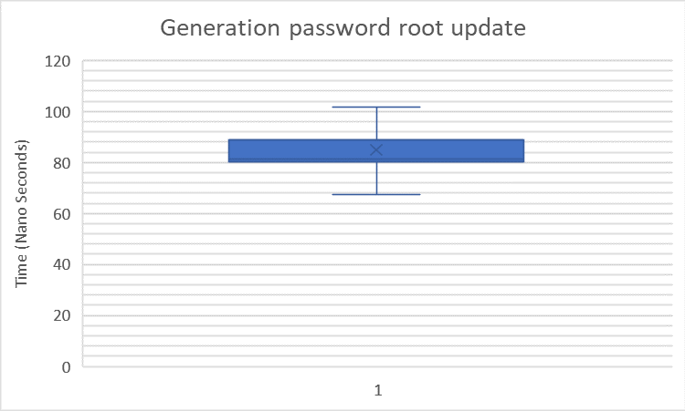
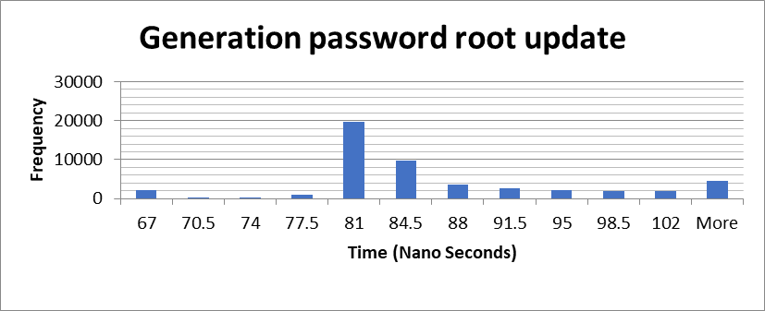
Generation password root
50,000 timings of 50,000 executions of the password root only (no channel writing) Theoretical time per execution
Median Time: 81.3 Nanoseconds

Slide 25
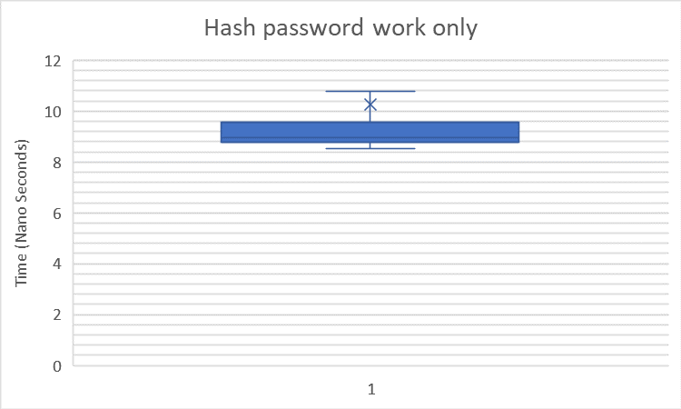
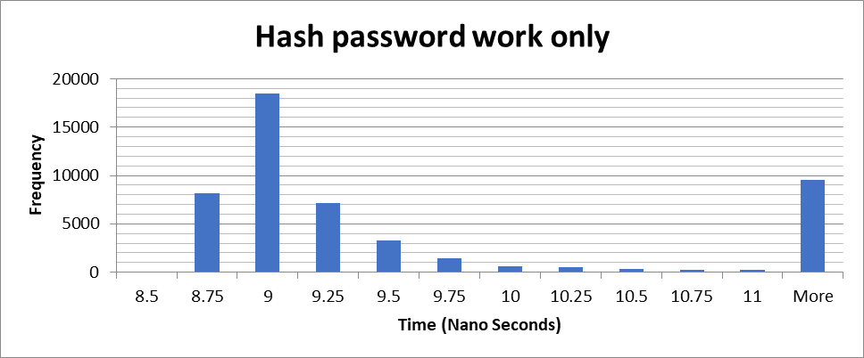
Hash password
50,000 timings of 50,000 executions of password hashing only (no channel read/writing) Theoretical time per execution
Median Time: 8.94 Nanoseconds

Slide 26
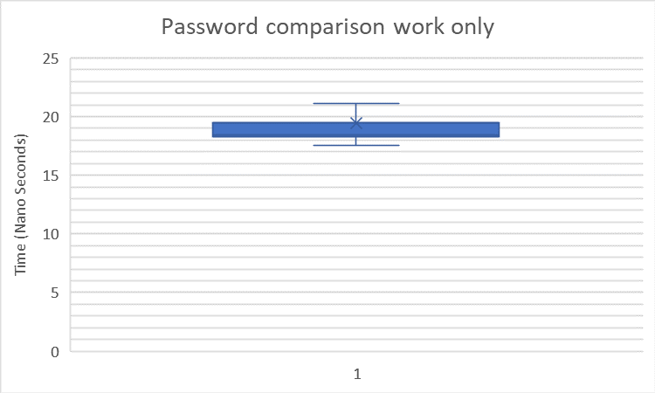
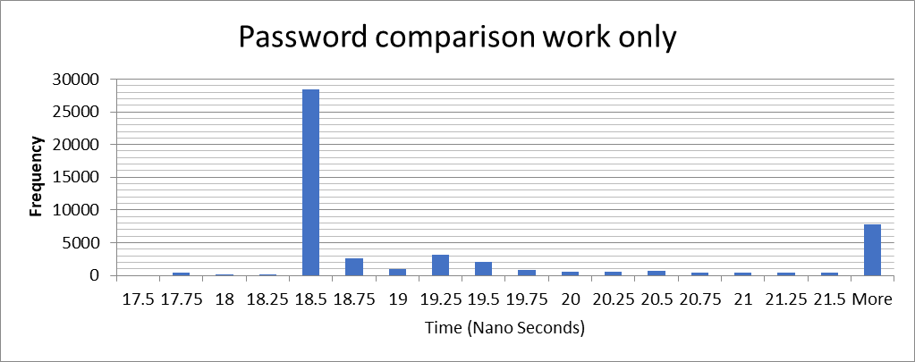
Hash comparison
50,000 timings of 50,000 executions of hash comparison work only (no channel reading) Theoretical time per execution
Median Time: 18.44 Nanoseconds

Slide 27
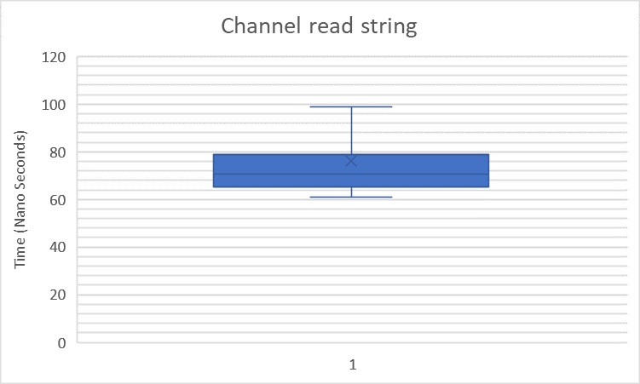
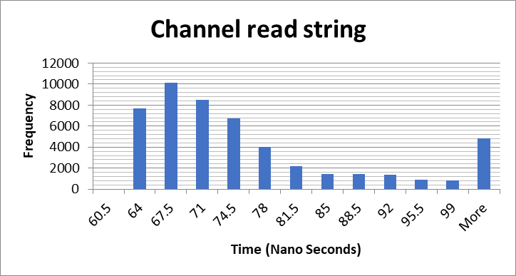
Channel reading string
50,000 timings of 50,000 executions of reading a string from a channel
Theoretical time per execution
Median Time: 70.56 Nanoseconds

Slide 28
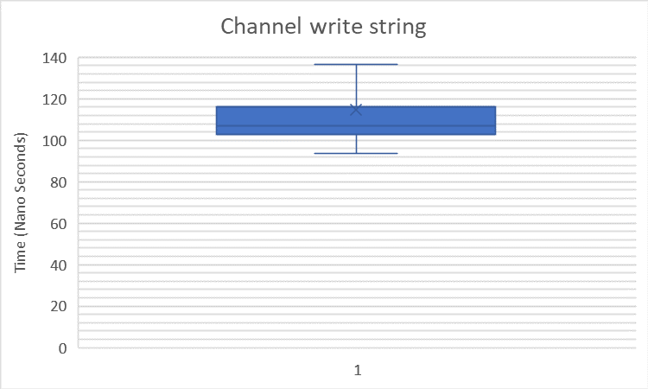
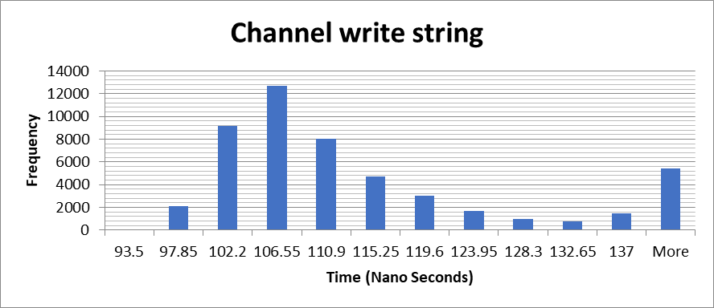
Channel writing string
50,000 timings of 50,000 executions of writing a string to a channel
Theoretical time per execution
Median Time: 106.98 Nanoseconds

Slide 29
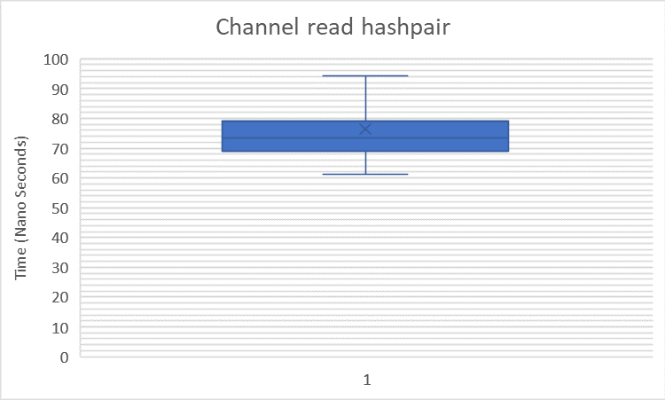
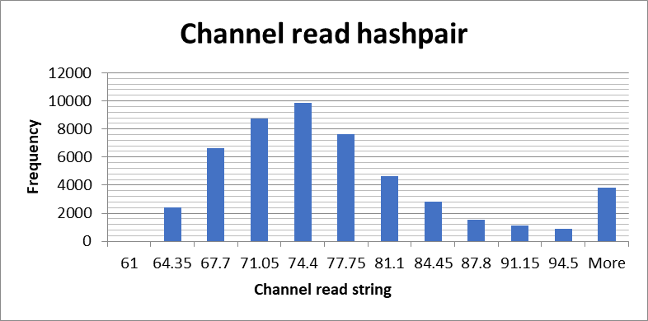
Channel reading hashpair
50,000 timings of 50,000 executions of reading a string and hash from a channel
Theoretical time per execution
Median Time: 73.56 Nanoseconds

Slide 30
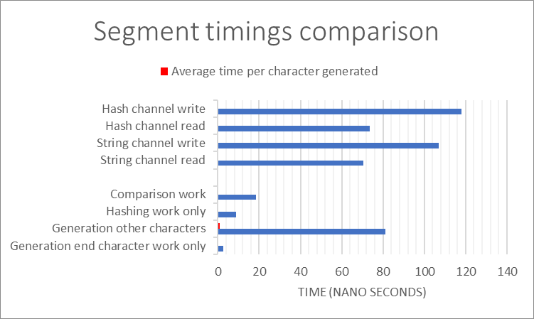
Comparison
Generation: Single character, string channel writing, 1/95th of root password updating
Hashing: Hash, string channel reading, hashpair channel writing
Comparison: Hash comparison, haspair channel reading

Slide 31
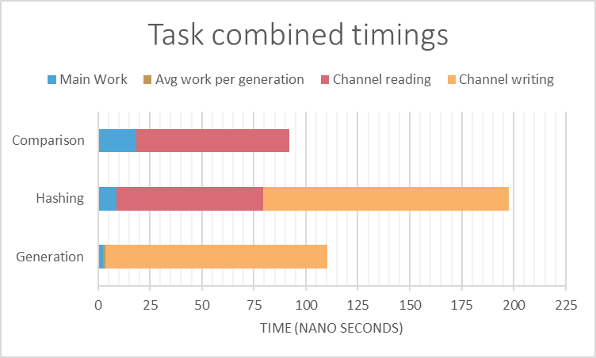
Total comparison
Generation: 110.5ns
Hashing: 197.5ns
Comparison: 92ns
Hashing approximately twice as slow as generation and comparison.
Therefore two threads for ever comparison and generation thread.

Slide 32
Control
Task | Time per guess per thread (Ns) | Threads | Time per guess all threads (Ns)
Password root increment | 0.8558 | 1 | 0.8558
Password last character increment | 220.056 | 1 | 220.056
Hashing | 395 | 1 | 395
Comparison | 184 | 1 | 184
Total (Theoretical) | 799.912 | 4 | 799.912

Slide 33
Optimisation
Task | Time per guess per thread (Ns) | Threads | Time per guess all threads (Ns)
Password root increment | 0.8558 | 1 | 0.8558
Password last character increment | 220.056 | 1 | 220.056
Hashing | 395 | 2 | 197.5
Comparison | 184 | 1 | 184
Total (Theoretical) | 799.912 | 5 | 602.412

Slide 34
Prediction
Control theoretical time per guess | Optimised theoretical time per guess
799.912 | 602.412
$\frac{\text{799.912 }}{\text{602.412 }} =\text{3}\text{2.8}\text{\%}$ Theoretical time improvement
$$Time to crack = ([Theoretical time per guess]∗({[number of characters in characterset]}^{[number of characters in password]}))/2$$
Number of letters in password | Control time predictions | Optimised time predictions
1 | 38.0μs | 28.6μs
2 | 3.61ms | 2.72ms
3 | 0.343s | 0.258s
4 | 32.6s | 24.5s
5 | 51.6min | 38.8min

Slide 35
Results
Number of letters in password | Control time actual | Optimised time actual
1 | 0.006827s | 0.009286s
2 | 0.011002s | 0.012724s
3 | 0.373407s | 0.284701s
4 | 27.983454s | 25.69767s
5 | 3226.772s | 2461.094s
1-3: median of 10,000 timings
4: median of 100 timings
5: median of 3 timings

Slide 36
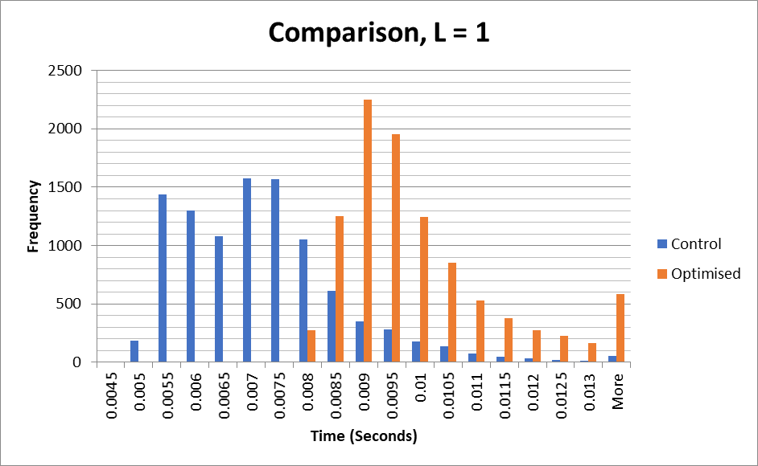
Results, number of letters = 1
10,000 timings
Timings are fairly erratic
Control has clear advantage over optimisation
Median:
Control: 0.006827s
Optimised: 0.009286s
Control 0.002459s (36%) faster

Slide 37
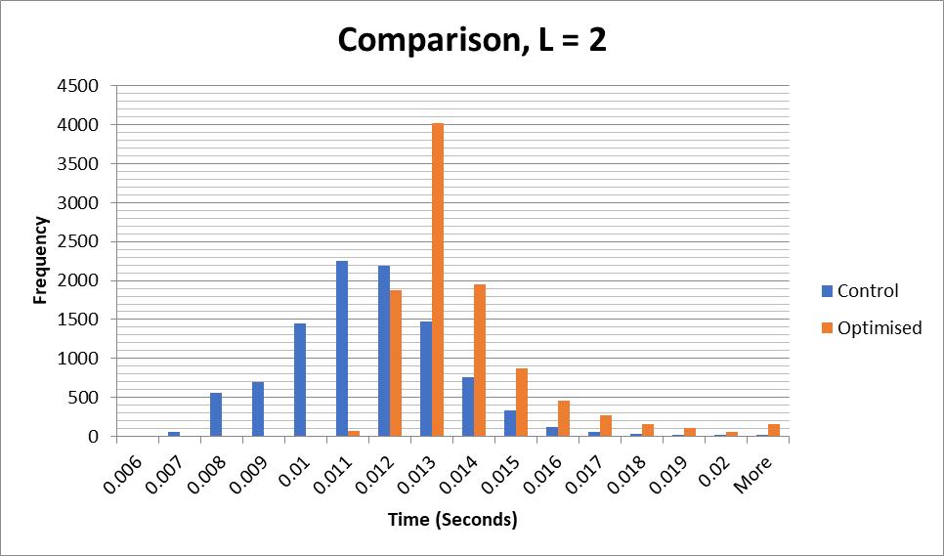
Results, number of letters = 2
10,000 timings
Timings more consistent
Control still faster than optimisation
Median:
Control: 0.011002s
Optimised: 0.012724s
Control 0.001722 s (16%) faster

Slide 38
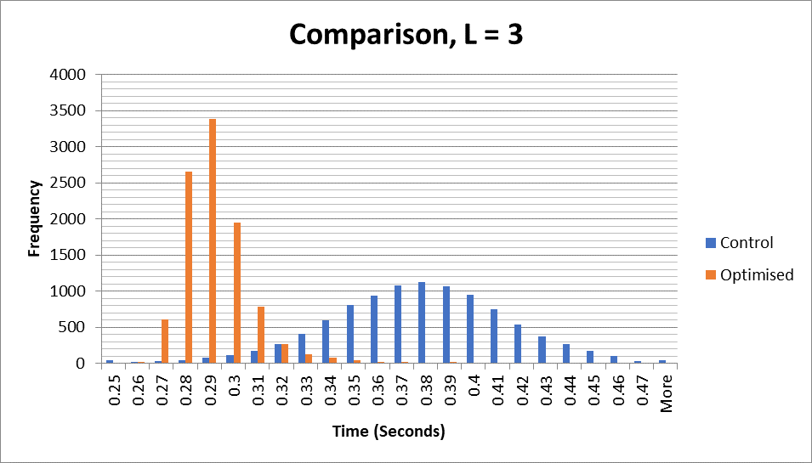
Results, number of letters = 3
10,000 timings
Timings very consistent
Control still faster than optimisation
Median:
Control: 0.373407s
Optimised: 0.284701s
Optimisation 0.08871s (31%) faster, in line with predictions

Slide 39
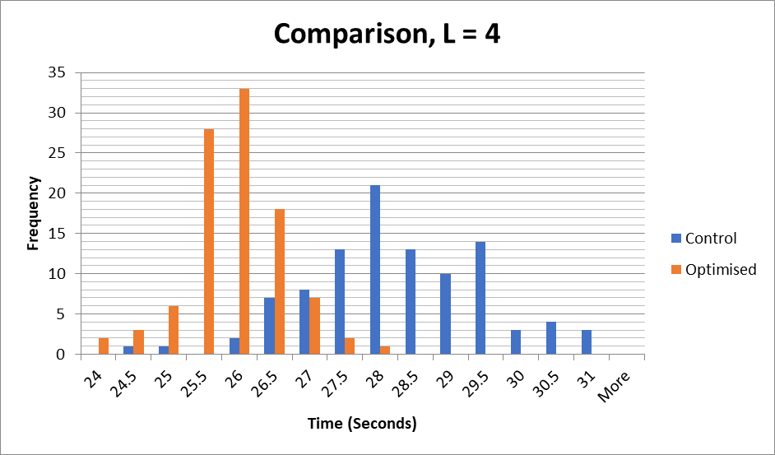
Results, number of letters = 4
100 timings
Far less statistically reliable but necessary due to time constrains
Still fairly statistically rigorous
Optimisation clearly has advantage
Median:
Control: 27.98345s
Optimised: 25.69767s
Optimisation 2.285784s (9%) faster

Slide 40
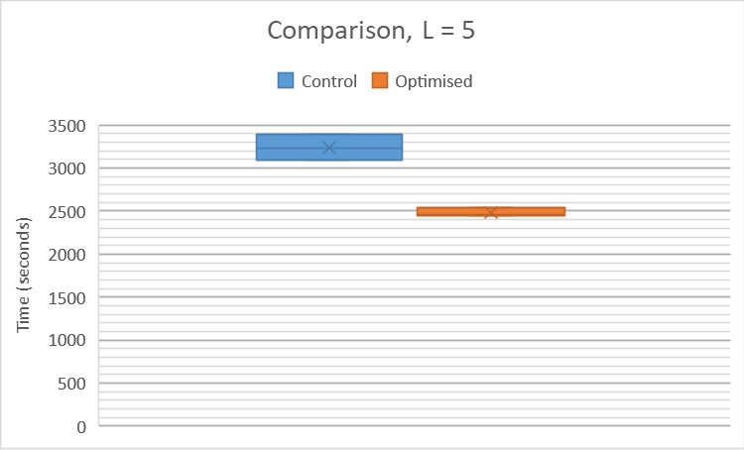
Results, number of letters = 5
3 timings
Not statistically rigorous but useful as indication
Optimisation clearly faster
Median:
Control: 3226.772s (00:53:47)
Optimised: 2461.094s (00:41:01)
Optimisation 765.6775s (00:12:46) (31%) faster, in line with predictions

Slide 41
Difference from prediction
Length of password | Predicted (seconds) | Actual (seconds) | Percentage error
Control: L =1 | 3.79958E-05 | 0.006827 | 17867.78%
L = 2 | 0.003609601 | 0.011002 | 204.80%
L = 3 | 0.342912095 | 0.373407 | 8.89%
L = 4 | 32.57664903 | 27.983454 | -14.10%
L = 5 | 3094.781657 | 3226.771973 | 4.26%
Optimised: L = 1 | 2.86146E-05 | 0.009286 | 32352.02%
L = 2 | 0.002718382 | 0.012724 | 368.07%
L = 3 | 0.258246314 | 0.284701 | 10.24%
L = 4 | 24.53339981 | 25.69767 | 4.75%
L = 5 | 2330.672982 | 2461.094482 | 5.60%

Slide 42
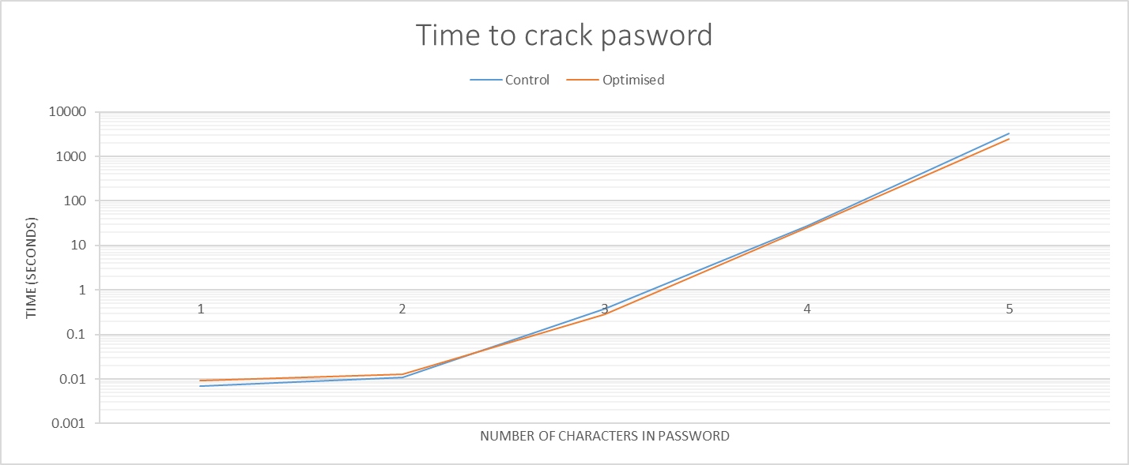
Results
For number of characters 3-5 the optimisation was effective and timings were within 5-15% of what was predicted. However, for lower numbers the program did not behave at all as theorised and the optimisations made it run slower.

Slide 43
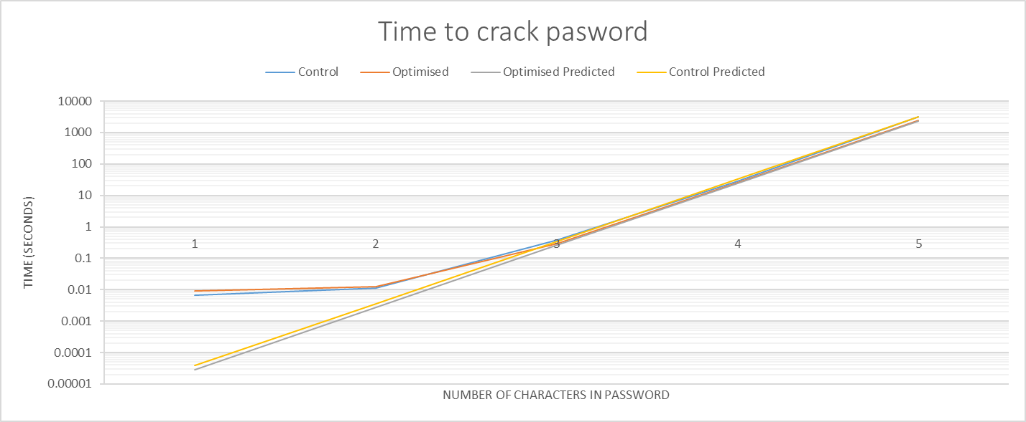
Results
When compared to the predicted it is clear there is some floor of how fast the solution can operate, at which it deviates from the theoretical time.

Slide 44
Explanation
This is likely due to the unpredictable yet significant amount of time it takes to launch a thread, this would also explain as to why the optimisation performed worse than the control for lower lengths; it had an additional thread to launch.
The allocation of memory and construction of channels and barriers would have a constant time cost that would become an increasingly small proportion of the execution time as the length of characters increase but would be a significant amount of execution time for the far faster running calls of one or two character password guesses.
At the low times a matter of milliseconds it could take of overhead for the operating system to get around to launching a new thread would have significant effects on the timings.

Slide 45
Conclusion
I would therefore say the optimisations with the thread arrangement offers a significant advantage, approaching a 32% improvement, over the naïvely segmented approach for non-trivial lengths of password.

Slide 46
Questions
1800231@uad.ac.uk

